Slide 1
Understanding the menstrual cycle and female athlete health
Vanessa Davies & Dr Natalie Brown

Slide 2
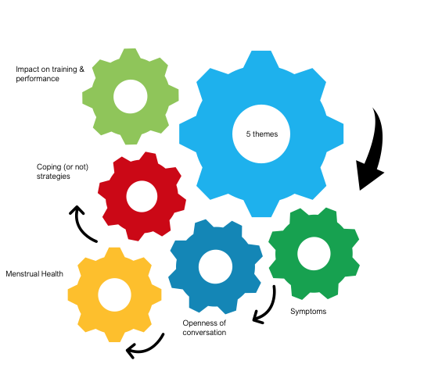
Female athlete interviews

Slide 3
Part 1- female menstrual health
What causes a menstrual cycle and associated hormones involved
What is considered ‘regular’ and ‘irregular’ in relation to the menstrual cycle
Explore how low energy availability affect the menstrual cycle and female health

Slide 4
The menstrual cycle as a vital sign
A regular period with only mild symptoms is an important marker of good underlying health.
'Having a menstrual cycle is like having an extra vital sign - like your pulse or body temperature. Your cycle can tell you when you’re in your usual rhythm, when something is a bit off or when you may have a medical condition that could need treatment. '

Slide 5
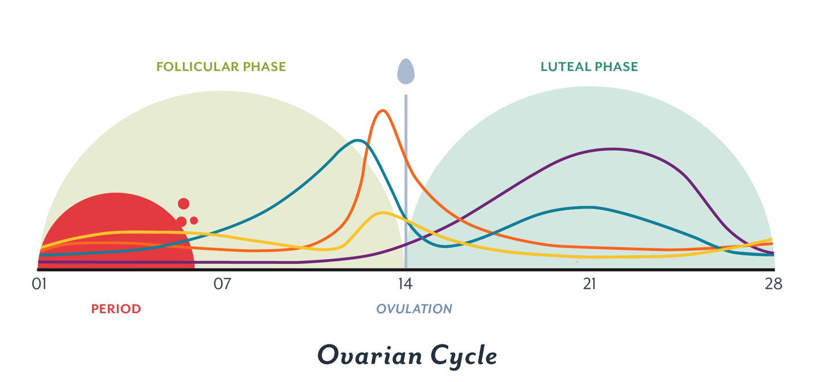
Menstrual cycle 101
Clumsy
Food cravings
Hormone | Produced | Role
FSH (follicle stimulating hormone) | Pituitary gland | Causes an egg to mature in an ovary. Stimulates the ovaries to release oestrogen
Oestrogen | Ovaries | Stops FSH being produced (so that only one egg matures in a cycle). Repairs, thickens and maintains the uterus lining. Stimulates the pituitary gland to release LH.
LH (luteinising hormone) | Pituitary gland | Triggers ovulation (the release of a mature egg)
Progesterone | Ovaries | Maintains the lining of the uterus during the middle part of the menstrual cycle and during pregnancy.
Feeling strong & energised
Decreased motivation
Lethargic
Moody
Irritable
Cramps
Bleeding
GI disturbance
Weight gain
Bloating
cramps
Figure adapted from helloclue.com

Slide 6
Influence on health and wellbeing
Healthy mood:
Oestrogen helps lift mood and motivation.​
Healthy metabolism & body weight:
Together, oestrogen and progesterone promote a healthy body weight by aiding healthy metabolism.
Healthy Bones:
Oestrogen and Progesterone are vital for bone health. A lack of oestrogen leads to decreased bone mass and strength (over time resulting in osteoporosis).

Slide 7
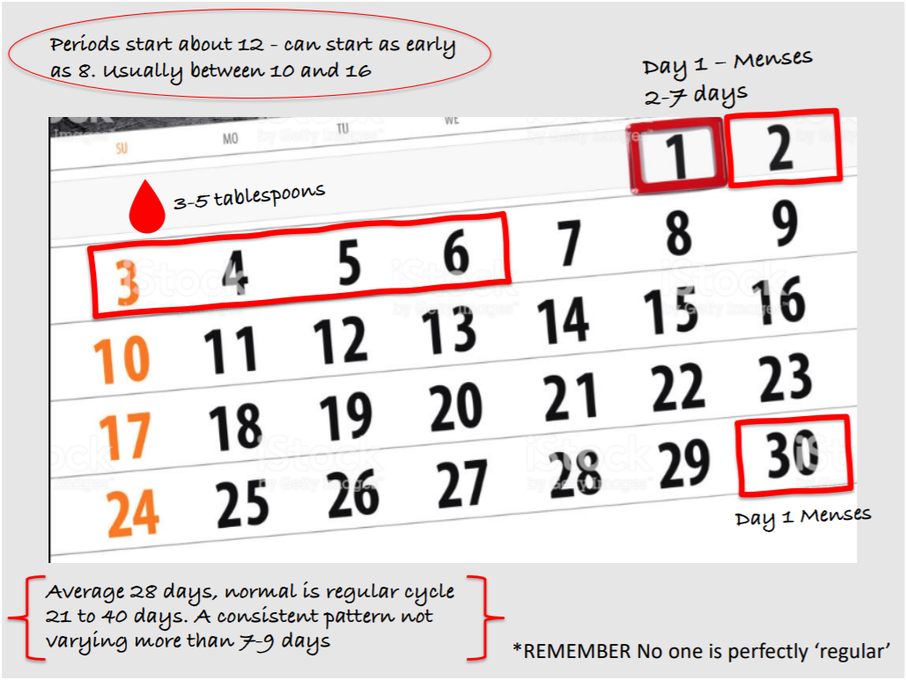
Regular and irregular
There are regular and irregular ranges for menstrual bleeding and pain/menstrual cramps.
After a few years, a menstrual cycle should generally be about the same length and volume each cycle.
The heaviness and length of your period depends on your hormones – they can change temporarily because of things like stress

Slide 8
Factors influencing regularity

Slide 9
Increasing awareness of chronic low energy availability
Over exercising or under fueling can cause Relative Energy Deficiency in Sport (RED-S) – energy imbalance
RED-S caused by low energy availability, where nutritional intake is insufficient to cover the energy demands of both exercise training and bodily processes or excessive training load reducing energy available to support life.
Difference between Female athlete Triad and RED-S, 2 models which interlink:
Triad considered to affect menstrual function & bone health
RED-S recognizes the larger impact it can have on all systems and can also affect males
Conversations are still discussing its ‘normal’ for periods to stop – this perception needs to change, it's not OK and has health implications

Slide 10
Low energy availability & menstrual health
Health4performance.co.uk

Slide 11
Relative energy deficiency in sport (RED-S)
Impaired growth & development
Impact on health & wellbeing
Adverse affect on performance
For female athletes’ regular menstrual cycle is a barometer of hormone health
Oral contraceptives can ‘mask’ problems, increasing risk due to undetected and no protection of bones

Slide 12
Actions
Actions
Coach understanding & education
Understanding LEA links to decreased immunity, stress fractures and poor performance
Athlete Education
Medical support where required
Changing commonly held beliefs- amenorrhoea
Athlete self monitoring
Promoting healthy training environment!
Wellbeing and support – person centered approach
Always carefully consider recommendations in changes to weight

Slide 13
Health & wellness for athlete performance
Increase awareness of positive aspects of energy - fuel is needed for performance
Prevention/awareness education
Look after the person first for long term development
Shared approach –Coaches, parents, athletes, support network. Medical support/seek help if athletes have not started their periods by age 15 or if athletes miss periods for 3months
Athlete monitoring self awareness

Slide 14
Menstrual health & performance
Figure from Health4performance.co.uk

Slide 15
http://health4performance.co.uk
Signposting and questions
Vanessa Davies – vanessa.davies@sport.wales
Dr Natalie Brown – natalie.brown@sport.wales

